Slide 1
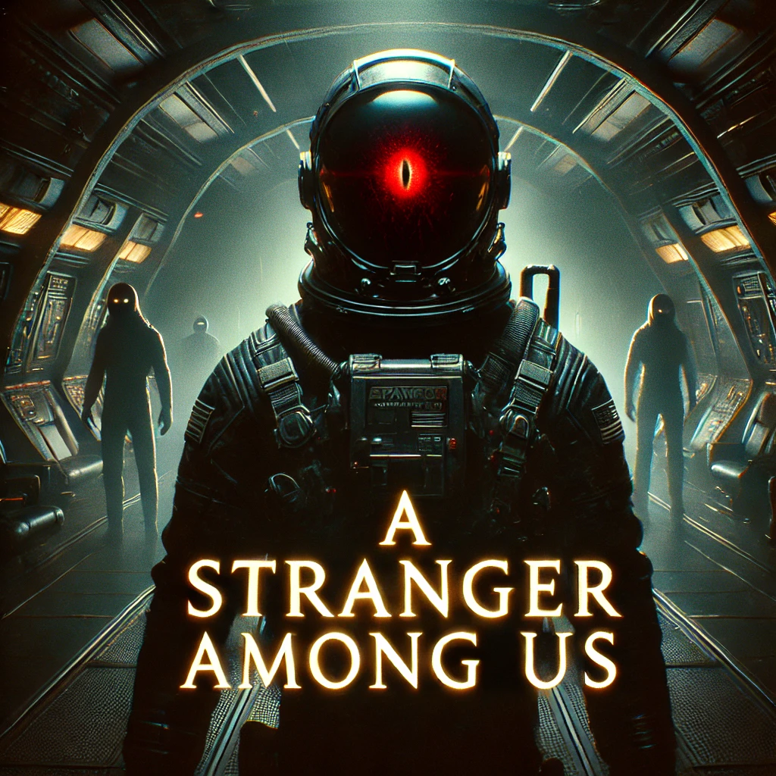
A Stranger Among Us
Strangers in a Strange Land
(Alex Burgos, Austin Geisert, Brendan Gipson)

Slide 2
What is A Stranger Among Us?
A game for Boomers who don’t want to play new games and those who are into very retro games without crappy micro-transactions. The game is a text adventure game that captures modern gameplay elements in a 1906-style command line interface. Unlike modern graphical games, our product relies on the user’s imagination to make the world come alive to make an epic adventure.

Slide 3
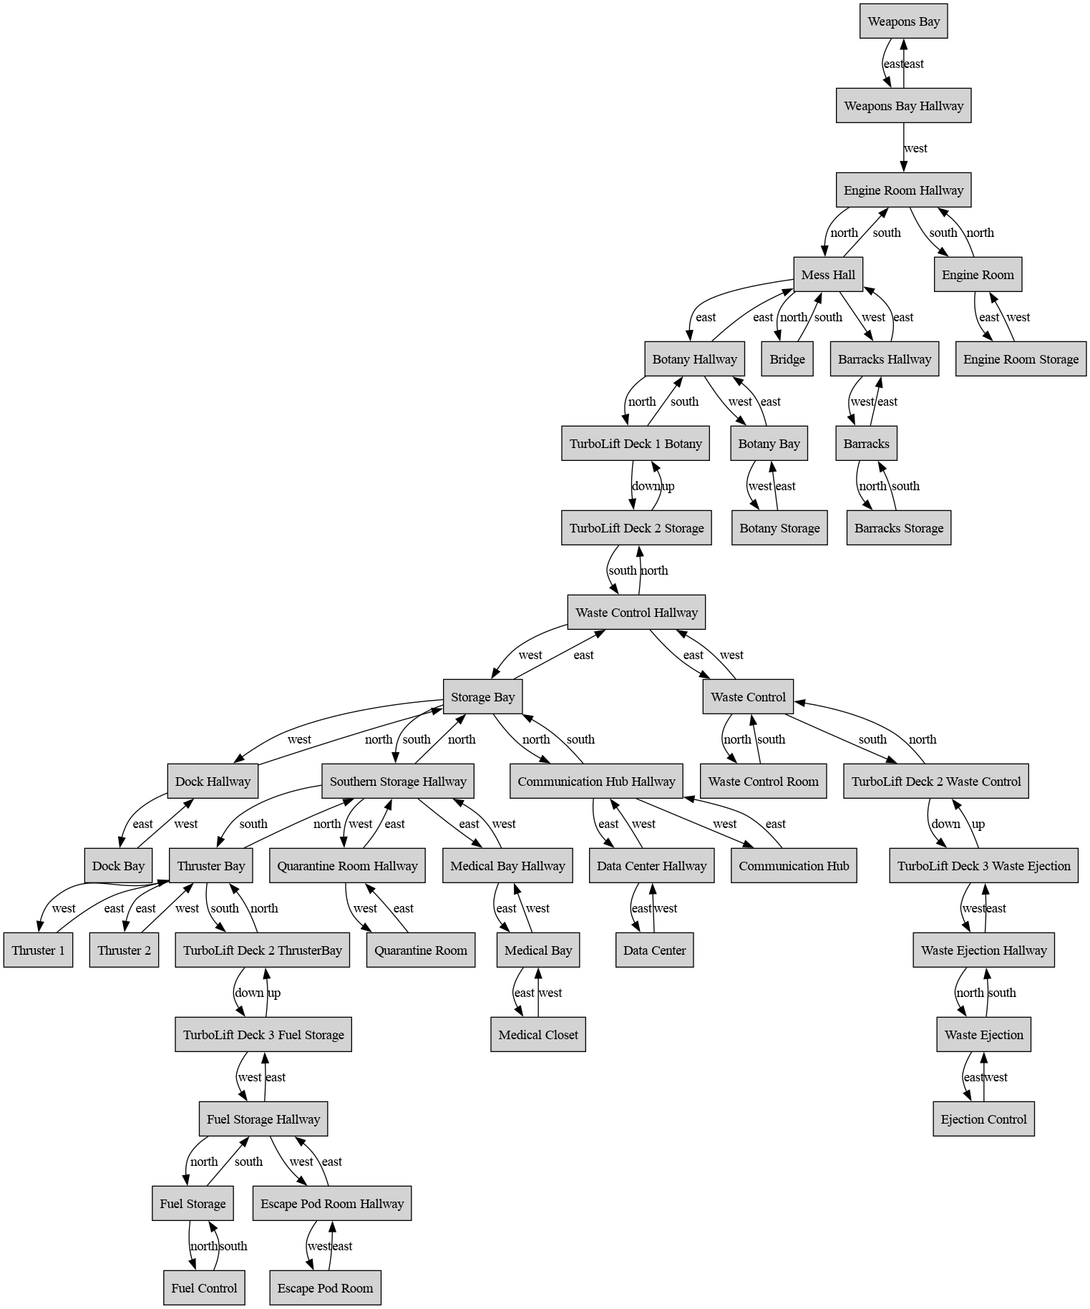
Game World
The game is set in a space station that has been disabled.
You must find your way around the station while collecting items in order to overcome several obstacles to reach the escape pod.
Get lost and take too long, the Stranger will find you, and it’s game over.

Slide 4
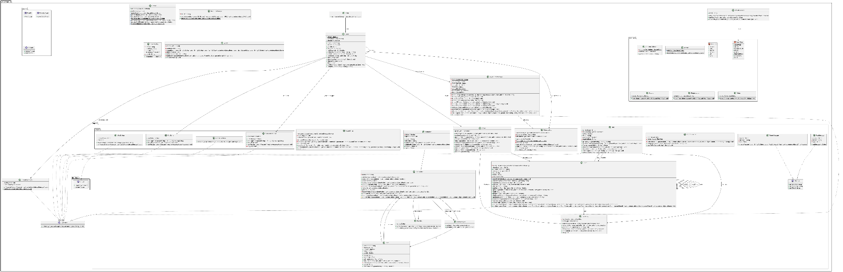
A more technical look with our UML chart for ants.

Slide 5
Important Code Pieces
Parser
Core of the game that processes the player’s input.
Uses a dictionary with verbs, nouns, prepositions, and articles to keep track of actions and objects that the player can interact with.
If the words are not in the dictionary, it gives the player an error messages.
Can make it difficult to interact with the game using more natural sentence structures unless you add more methods that process longer sentences.

Slide 6
Important Code Pieces
Message Bus
Asynchronous Message processing
Do you like Strings as your message?
Timers are created using the messaging system.
Triggers use the messaging system.
Our UML diagram looks strange.. Because of the messaging system

Slide 7
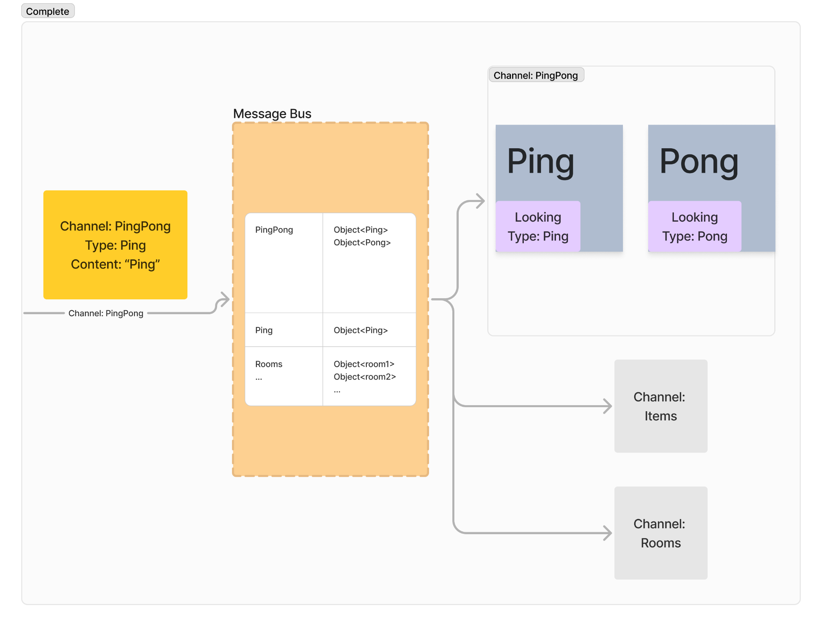

Slide 8
Important Code Pieces
Generator Trigger
Dialog Triggers
End Game trigger
Test suites
Map design and room layout

Slide 9
Lessons Learned
It was a difficult but fun process that forced us to use the methods learned in The Agile Samurai, especially when it was time to prioritize some features and cut others.
More features had to be added to make sure the initial features planned worked properly.
Refactoring to have elegant code would’ve been too time consuming so we kept all of the spaghetti code.
Writing tests first is actually pretty great.
Even a small program like this takes a substantial amount of testing.

